Slide 1
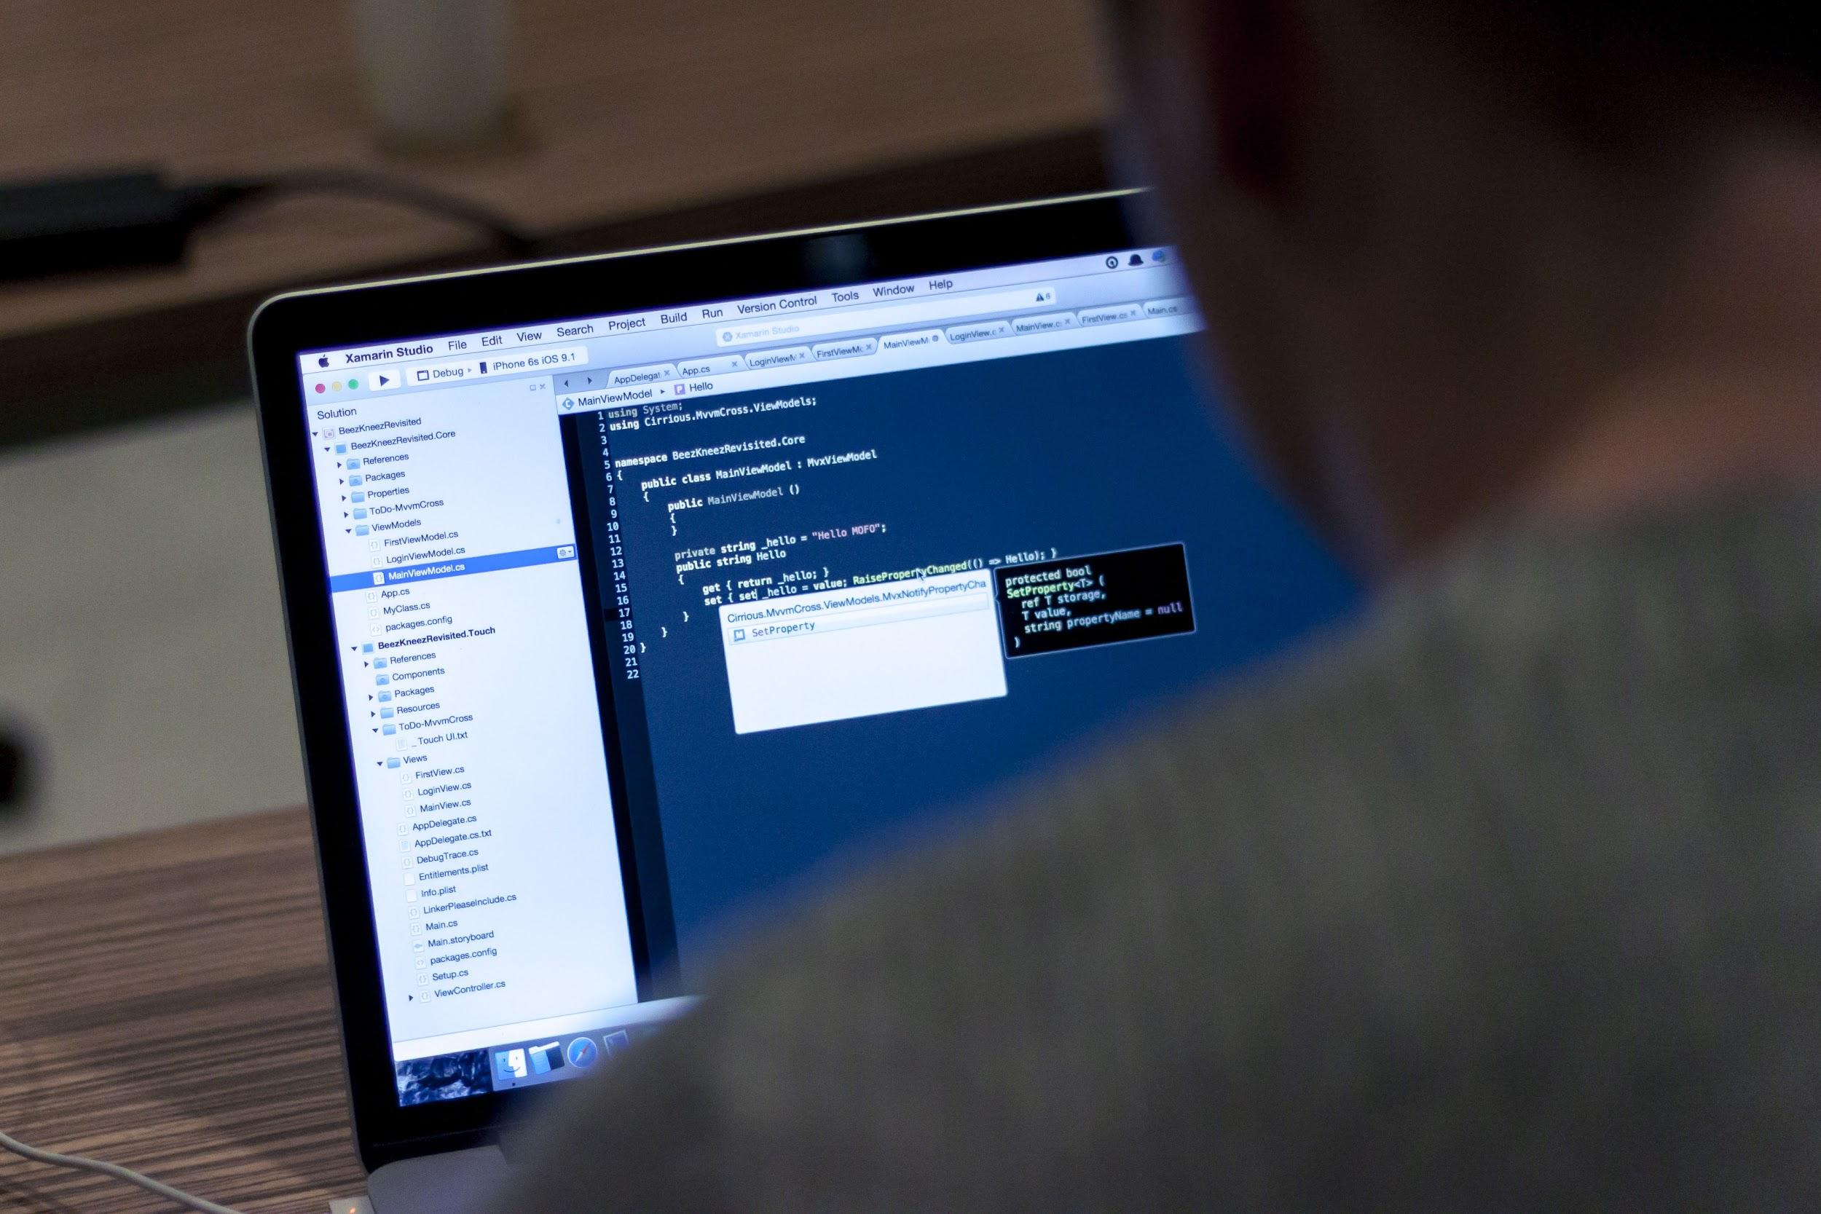
JavaScript 106
jQuery vs. Plain JS, Ajax

Slide 2

Prep for class
https://teamtreehouse.com/library/ajax-basics

Slide 3

Last Class Topics
Array Properties and Methods
length
indexOf()
join()
push()
pop()
unshift()
shift()
jQuery

Slide 4
Today’s Topics
jQuery vs Plain JS
Caching DOM
Listening to Events
Manipulating HTML
Toggling Classes
Ajax
What is Ajax
What is JSON
Why you would use it
How to use AJAX and jQuery

Slide 5
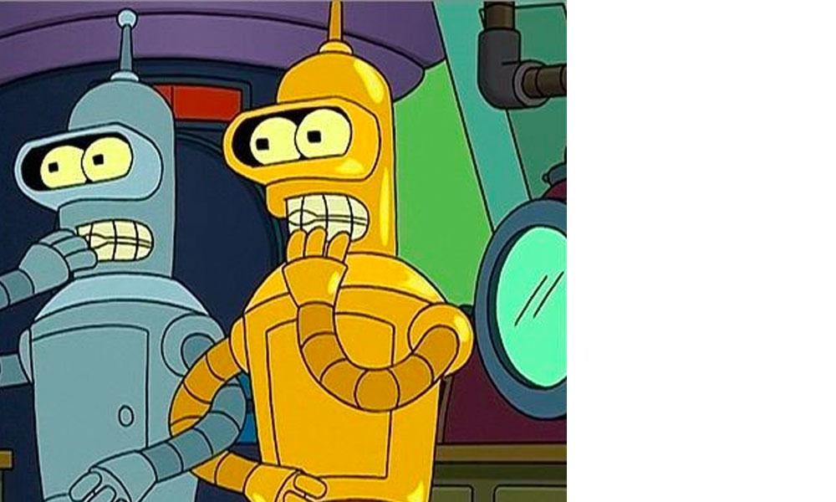
jQuery vs Plain JS
How does jQuery make my life easier?

Slide 6
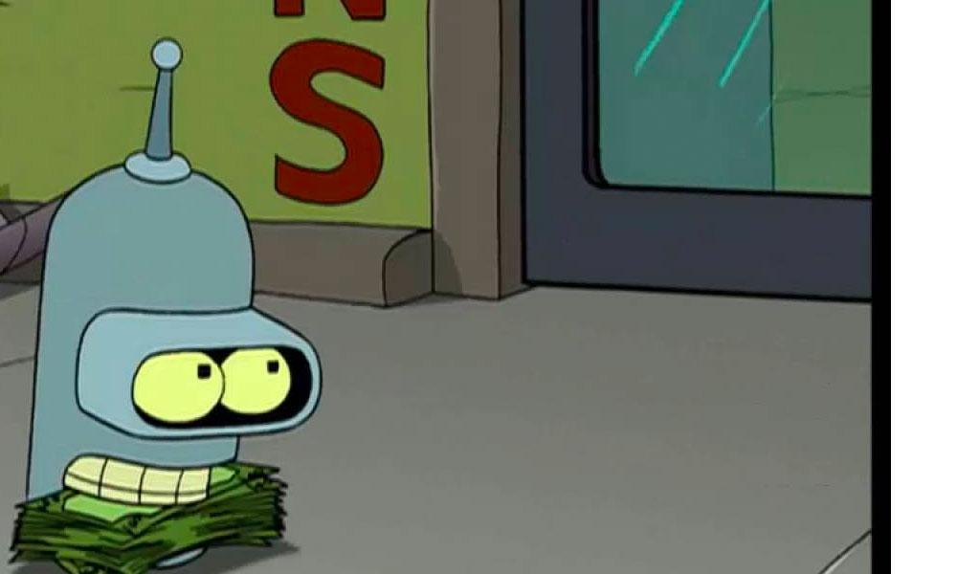
Caching the DOM
We have seen how to use JavaScript to select the DOM elements, and we looked at the jQuery way of selecting elements. Now let’s look at them back to back and compare the differences.
// Plain JavaScript var userDisplay = document.querySelector('#userDisplay'); var allLI = document.querySelectorAll('#nav li'); // jQuery var userDisplay = $('#userDisplay'); var allLI = $('#nav li');

Slide 7
Listening to Events
Once upon a time, the DOM was a mess. Each browser, and sometimes browser versions, implemented the JavaScript spec differently or not at all. One of those items was, addEventListener
This is where jQuery came in to save the day. jQuery created an API to handle the differences between browsers. With one method, you can add an event listener and be assured that it's going to work in all the browsers.
// jQuery var $button = $('#button'); $button.on('click', function(e){ e.preventDefault(); // do stuff });
// Plain JS var button = document.querySelector('#button'); button.addEventListener('click', function(e){ e.preventDefault(); // do stuff });

Slide 8
Manipulating Text
Most things in jQuery have a method to either get or set a value of something.
Let’s look at how to get an element's innerText and the change it.
// index.html file
<div id="welcomeDisplay">Hello Welcome to JavaScript</div>
// main.js file
var $welcomeDisplay = $('#welcomeDisplay'); console.log($welcomeDisplay.text()); $welcomeDisplay.text('Welcome Everybody!');
// index.html file
<div id="welcomeDisplay">Hello Welcome to JavaScript</div>
// main.js file
var welcomeDisplay = document.querySelector('#welcomeDisplay'); console.log(welcomeDisplay.innerText); welcomeDisplay.innerText = 'Welcome Everybody!';

Slide 9
Toggle Classes
In the image toggle exercise, we needed to check if an item had a particular class. If it did, then we removed it, if it didn’t then we added it.
// index.html file
<div class="someImg"><img src="http://lorempixel.com/25/25" alt=""></div> <a href="#" id="toggleBtn">Toggle img</a>
// main.js file
var $toggleBtn = $('#toggleBtn'); $toggleBtn.on('click', function(e){ e.preventDefault(); if( $('.someImg').hasClass('isHidden') ){ $('.someImg').removeClass('isHidden'); }else{ $('.someImg').addClass('isHidden'); } // or use the toggle method $('.someImg').toggle('.isHidden'); });
// main.js file
var toggleBtn = document.querySelector('#toggleBtn'); toggleBtn.addEventListener('click', function(e){ e.preventDefault(); var someImg = document.querySelector('.someImg'); if(someImg.classList.contains('isHidden')){ someImg.classList.remove('isHidden'); }else{ someImg.classList.add('isHidden'); } });

Slide 10

https://oscarotero.com/jquery/
Interactive jQuery Cheat Sheet

Slide 11
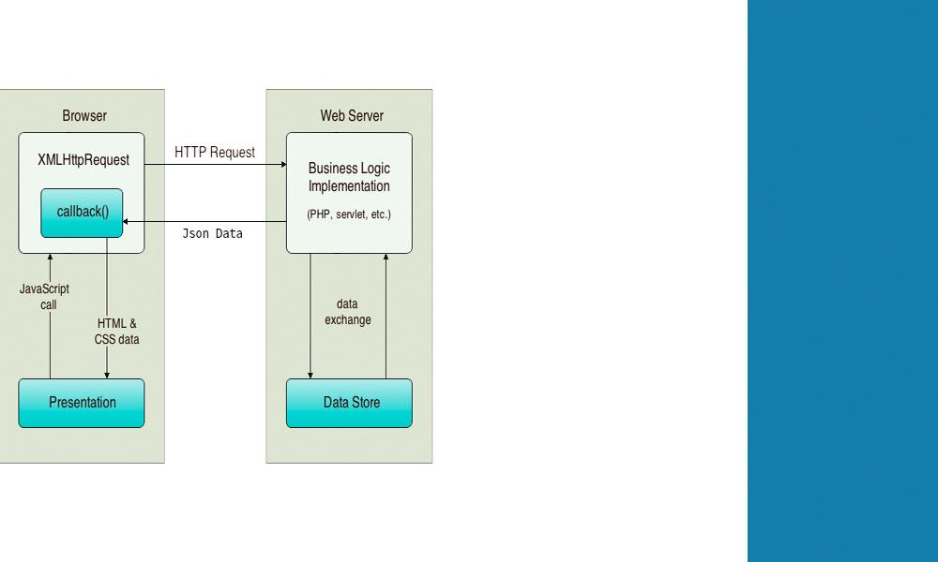
Ajax
Fetching data without a page reload

Slide 12
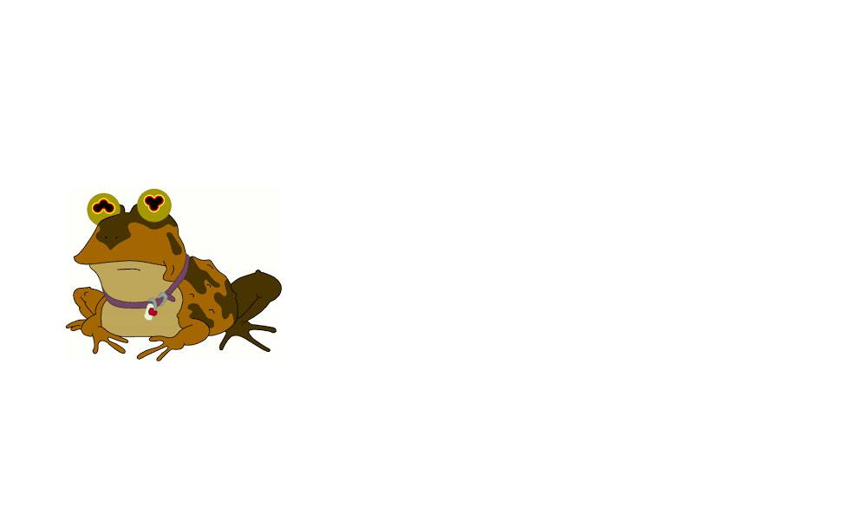
What is Ajax?
AJAX stands for Asynchronous JavaScript and XML.
AJAX is a technique for creating better, faster, and more interactive web applications with the help of XML, HTML, CSS, and JavaScript.
Although XML is in its title, the technology supports JSON, which is what we will use in this course.

Slide 13
What is JSON?
JSON stands for JavaScript Object Notation.
JSON is a lightweight data-interchange format. Its main purpose is to store data in a way that is easy for humans to read as well as machines to parse and generate.

Slide 14
JSON is the same format as JavaScript objects. Formally, the key names must be in double quotes. Casually, single quotes--and even no quotes--might be allowed, depending on the program.
[
{
"userId": 1,
"name": { "first": "Philip", "middle": "Jay", "last": "Fry" },
"info": { "age": "25", "gender": "Male", "species": "Human", "homePlanet": "Earth" },
"occupation": "Intergalactic Delivery Boy",
"sayings": ["Shut up and take my money!", "I'm walking on sunshine, woah oh oooh"]
},
{
"userId": 2,
"name": { "first": "Turanga", "middle": "", "last": "Leela" },
"info": { "age": "32", "gender": "Female", "species": "Mutant", "homePlanet": "Earth" },
"occupation": "Captain and pilot",
"sayings": ["You gotta do what you gotta do", "I don't have good depth perception "]
}
]

Slide 15

Why use AJAX?
AJAX can be used for a multitude of reasons. The most common one being retrieving data from a server, without reloading the whole page.
Or.
You have a game and are tracking the user score. You could periodically save the user score to a database without stopping the user from playing the game.
Or.
You have a list of employees on a page, and when the user clicks on a specific item, the program gets the relevant information to display on the screen.
The list goes on.

Slide 16
How to use AJAX
$.ajax({ method: "GET", url: "https://jsonplaceholder.typicode.com/posts", dataType: "json", beforeSend: function(){ // turn on loader animation
} }) .done(function( data ) { console.log( data ); }) .fail(function(err){ console.log(err); }) .always(function(){ // turn off loader animation });

Slide 17
Let’s play with some APIs already.
http://swapi.co/
https://developer.marvel.com/
https://freemusicarchive.org/api
https://jsonplaceholder.typicode.com/
https://anapioficeandfire.com/
https://opentdb.com/
http://jservice.io/

Slide 18

Let’s review
jQuery vs Plain JS
We saw how to achieve the same things with jQuery vs what we did in Plain JavaScript
AJAX
Asynchronous JavaScript and XML.. we will use it to grab JSON most of the time.
JSON
JavaScript Object Notation.
( Looks a lot like an object )
jQuery Ajax example
$.ajax().done().fail().always();

